Slide 1
NextHikes IT Solutions
Twitter Disaster Tweet Classification Using Machine Learning and Hugging Face
Presented By Harsimran Kaur

Slide 2
Problem Statement & Objective
Problem Statement
Millions of tweets are posted every day during emergencies and natural disasters.
It is difficult to manually identify disaster-related tweets from non-disaster tweets.
A fast and automated system is required to classify tweets accurately.
Such a system can help emergency response teams identify critical information quickly.
Objective
Develop a machine learning model to classify tweets as Disaster or Non-Disaster.
Perform tweet preprocessing and feature extraction using TF-IDF.
Enhance prediction using Hugging Face Sentiment Analysis (DistilBERT SST-2).
Deploy the trained model using a Streamlit Dashboard for real-time prediction.

Slide 3
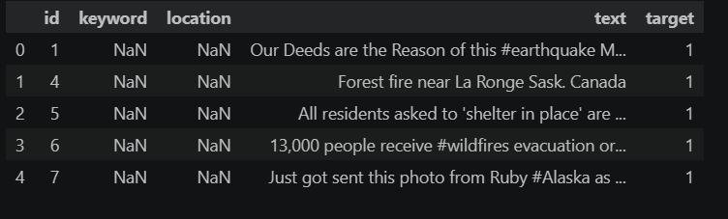
Dataset Overview
Dataset Name
Twitter Disaster Tweets Dataset (Kaggle)
Description
The dataset contains tweets collected from Twitter.
Each tweet is labeled as either Disaster or Non-Disaster.
The dataset is used to train a machine learning model for tweet classification.
Dataset Summary
Total Records: 7,613
Disaster Tweets: 3,271
Non-Disaster Tweets: 4,342

Slide 4
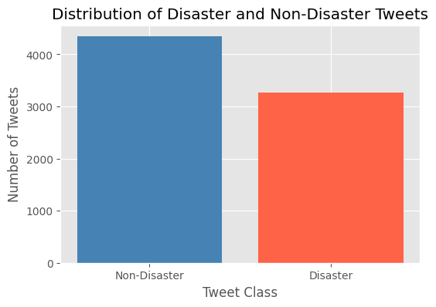
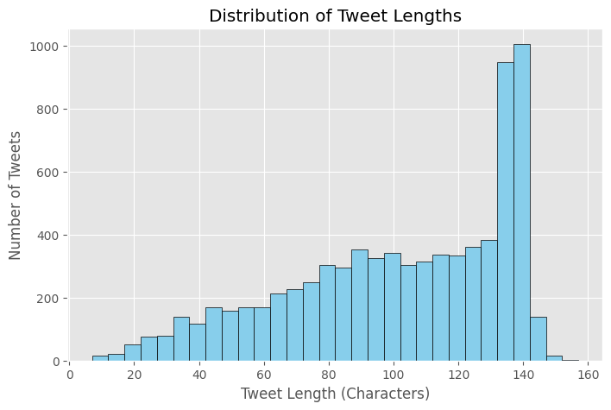
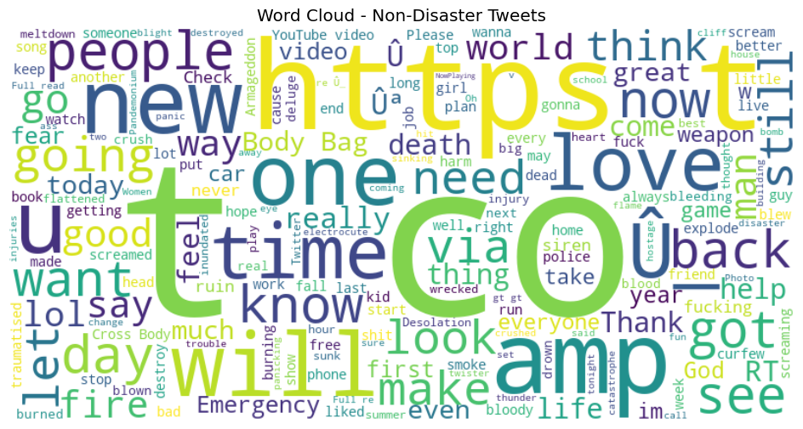
Exploratory Data Analysis (EDA)
Key Observations
The dataset contains slightly more Non-Disaster Tweets than Disaster Tweets.
Disaster tweets commonly include words such as fire, storm, earthquake, and emergency.
Non-Disaster tweets contain more general and everyday conversation words.
Exploratory Data Analysis helped understand the dataset before feature extraction and model training

Slide 5
Project Methodology
┌─────────┐ ┌────────────┐ ┌──────┐ ┌────────┐
│ Dataset │→→│Preprocess │→→│ EDA │→→│ TF-IDF │
└─────────┘ └────────────┘ └──────┘ └────────┘
│
▼
┌─────────────┐ ┌─────────────┐ ┌──────────────┐
│ Hugging Face│→│ Logistic Reg │→│ Prediction │
└─────────────┘ └─────────────┘ └──────────────┘
│
▼
┌────────────────┐
│ Streamlit App │
└────────────────┘

Slide 6

Model Training & Feature Engineering
Feature Engineering
Tweets were converted into numerical features using TF-IDF Vectorization.
Sentiment analysis was performed using the Hugging Face Transformers Pipeline.
Sentiment labels were encoded into numerical values.
TF-IDF features and sentiment features were combined into a single feature matrix.
Machine Learning Model
Algorithm Used
Logistic Regression
Train-Test Split
Training Data: 80%
Testing Data: 20%
Model Purpose
Classify tweets into:
🚨 Disaster Tweet
✅ Non-Disaster Tweet
Libraries Used
Scikit-learn
Hugging Face Transformers
Pandas
NumPy
Joblib

Slide 7

Model Performance Evaluation
Evaluation Metrics
The trained Logistic Regression model was evaluated using standard classification metrics.
Accuracy: (Add your actual accuracy here, e.g., 81.7% or whatever your notebook shows.)
Precision
Recall
F1-Score
Confusion Matrix
Key Results
The model successfully classified both Disaster and Non-Disaster tweets.
High accuracy was achieved using TF-IDF + Hugging Face sentiment features.
The confusion matrix shows the number of correct and incorrect predictions.

Slide 8
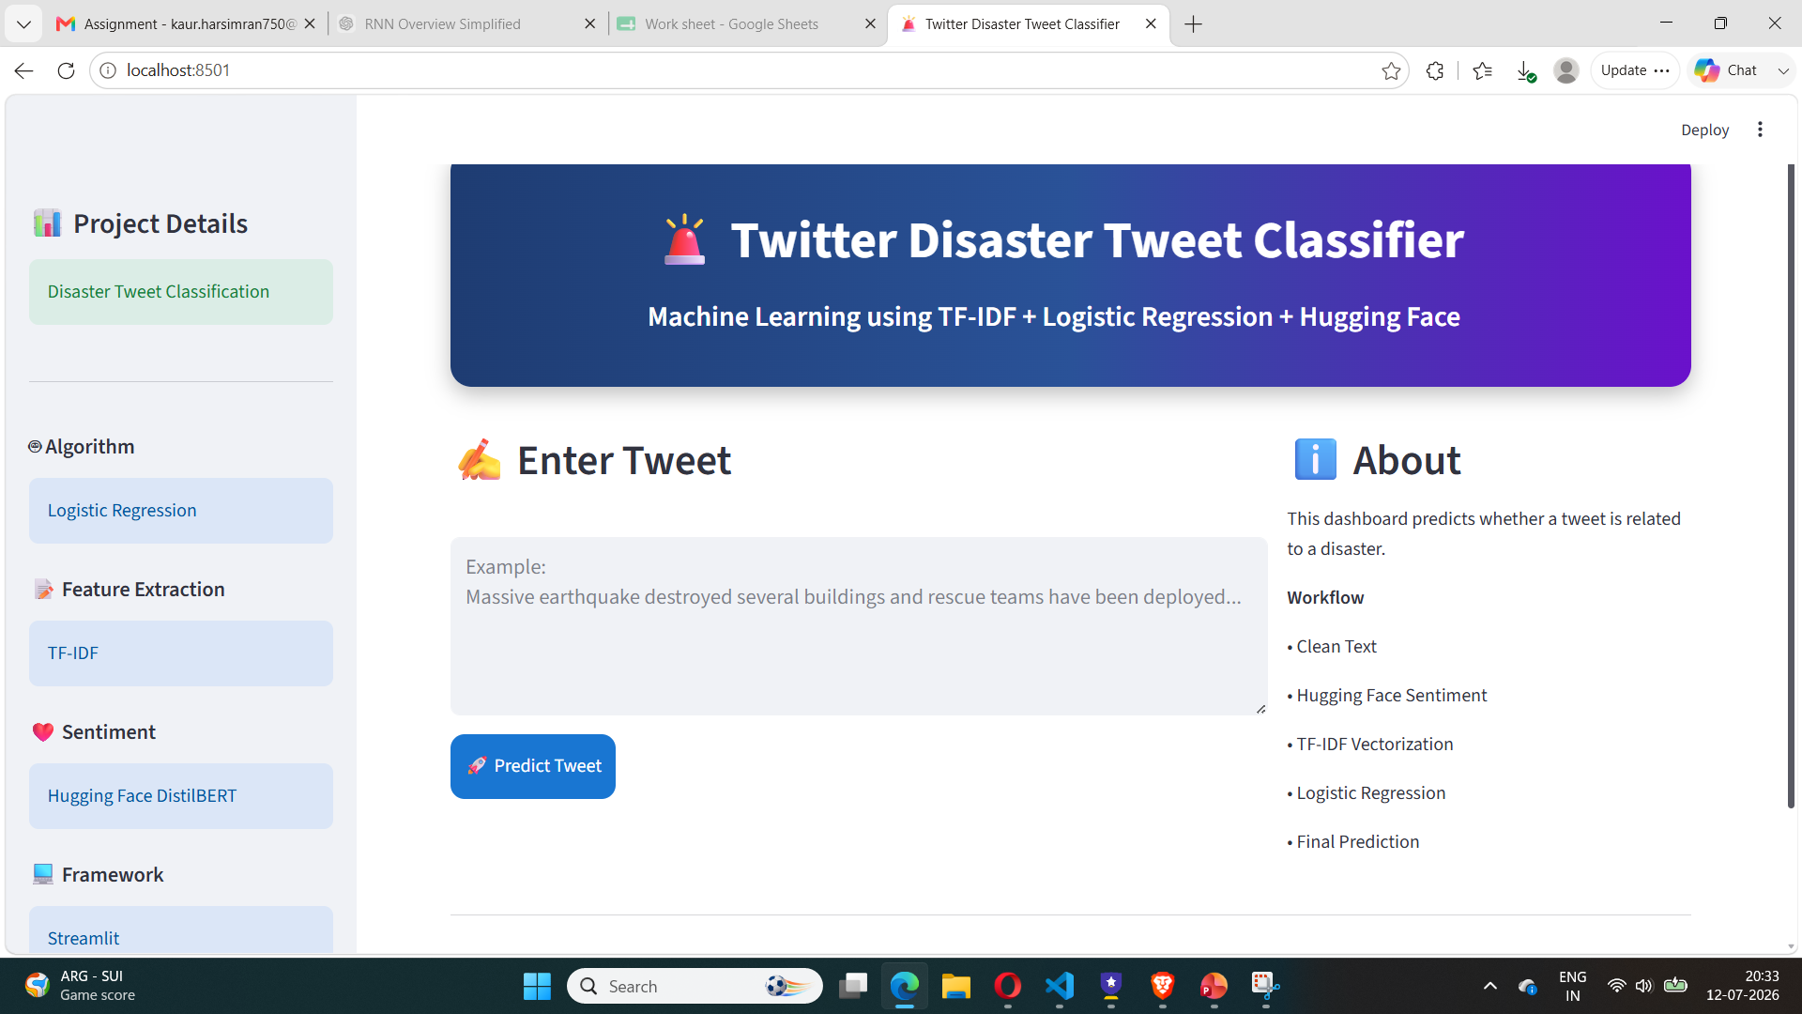
Streamlit Dashboard
Description
The trained machine learning model was deployed using Streamlit to provide real-time tweet classification.
Features
User-friendly interface
Enter any tweet for prediction
Real-time Disaster / Non-Disaster
classification
Model confidence score
Hugging Face sentiment
analysis
Cleaned tweet display

Slide 9
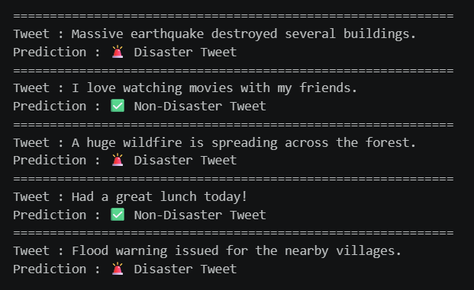
Sample Predictions
Key Highlights
Successfully classified disaster-related tweets.
Correctly identified normal everyday tweets as non-disaster.
Combined TF-IDF and Hugging Face sentiment features improved prediction quality.
Ready for real-time deployment using Streamlit.

Slide 10
Conclusion & Future Scope
Conclusion
Developed a machine learning model to classify tweets as Disaster or Non-Disaster.
Performed data preprocessing and exploratory data analysis to understand the dataset.
Applied TF-IDF for text feature extraction.
Integrated Hugging Face DistilBERT SST-2 for sentiment analysis.
Trained a Logistic Regression model for classification.
Successfully deployed the model using a Streamlit Dashboard for real-time predictions.
Future Scope
Improve accuracy using advanced transformer models such as BERT, RoBERTa, or DeBERTa.
Integrate the Twitter/X API for real-time tweet monitoring.
Support multiple languages for disaster detection.
Classify tweets by disaster type (e.g., Flood, Earthquake, Wildfire, Cyclone).
Deploy the application on a cloud platform for public access

Slide 11
Thank You

